Slide 1
Natural Language Processing
SemEval-2019

Slide 2
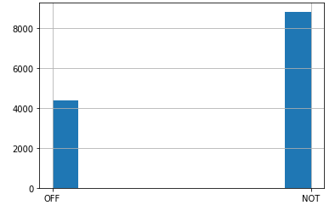
Subtask A: Detecting Offensive language in social Media
Steps to complete subtask A and subtask B
Read tagged data from flat file in to dataframe
Plot the data distribution in histogram to check data balance

Slide 3
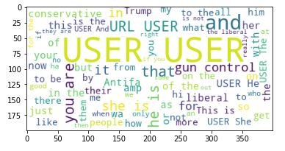
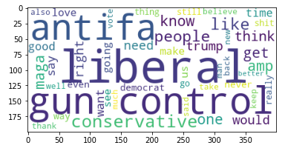
Subtask A: Detecting Offensive language in social Media
Remove Stopwords and decontract words
Plot the wordcloud to find the most repeated words
Clean process removes stop words from first word cloud to create second word cloud
Word Cloud before cleaning Word Cloud after cleaning

Slide 4
Subtask A: Detecting Offensive language in social Media
Lemmatize and stemm the words
Split data into training and validation sets
Use one hot encoding for input and output
Different Types of Model used for solving the problem
Convolution Model
LSTM Model
K Fold cross validation using Dense layers
Run Models
Calculate Model accuracy
Predict the output using

Slide 5
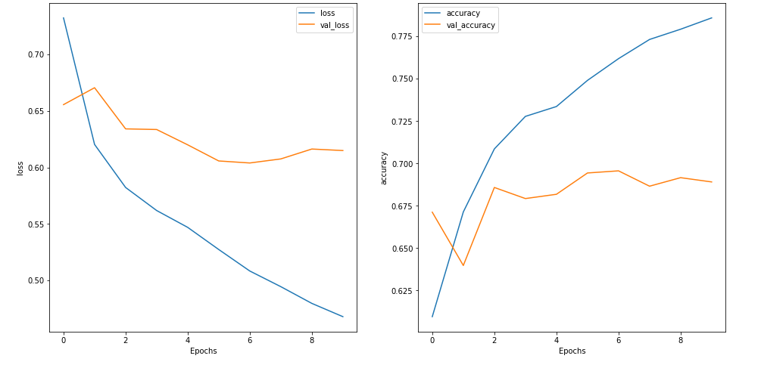
Subtask A: Detecting Offensive language in social Media
Convolution Model outputs

Slide 6
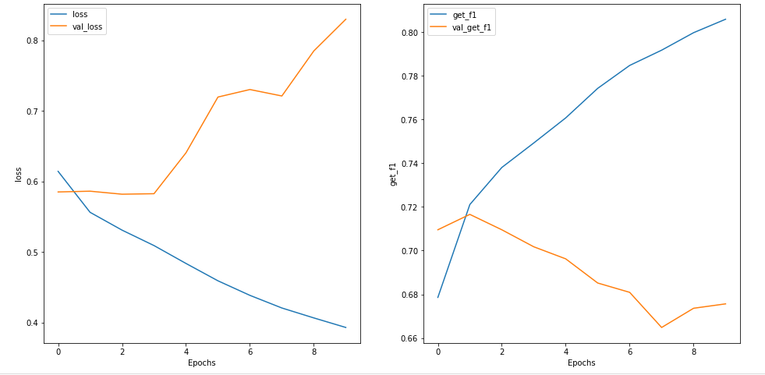
Subtask A: Detecting Offensive language in social Media
LSTM Model output

Slide 7
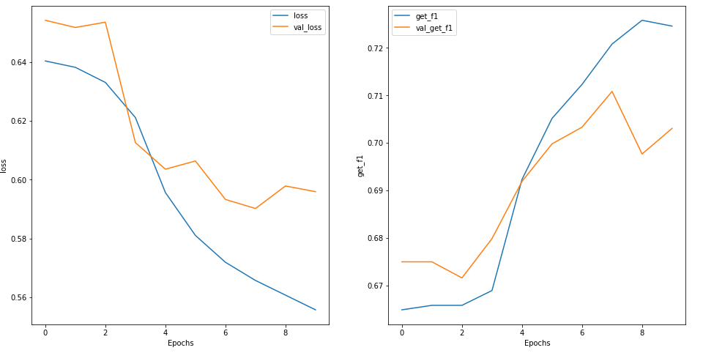
Subtask A: Detecting Offensive language in social Media
K-Fold Cross Validation using Only Dense layers

Slide 8
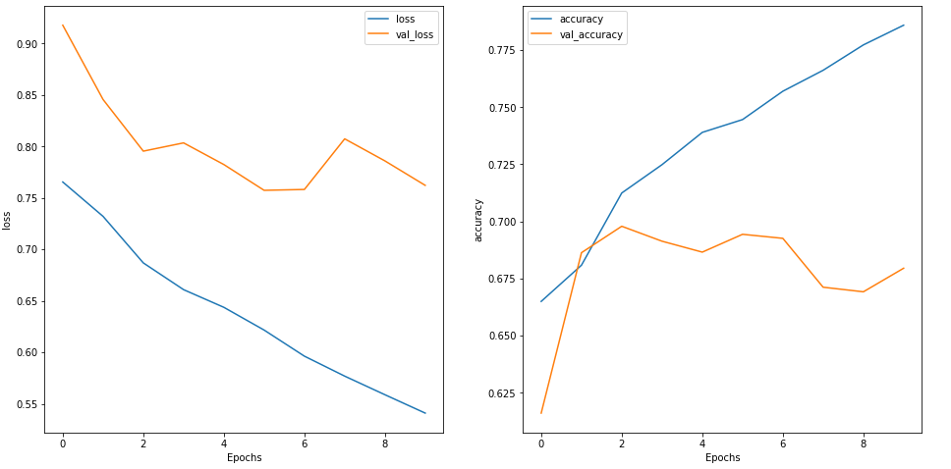
Subtask B: Detecting offensive language is targeted or untargeted
Convolution Model Output

Slide 9
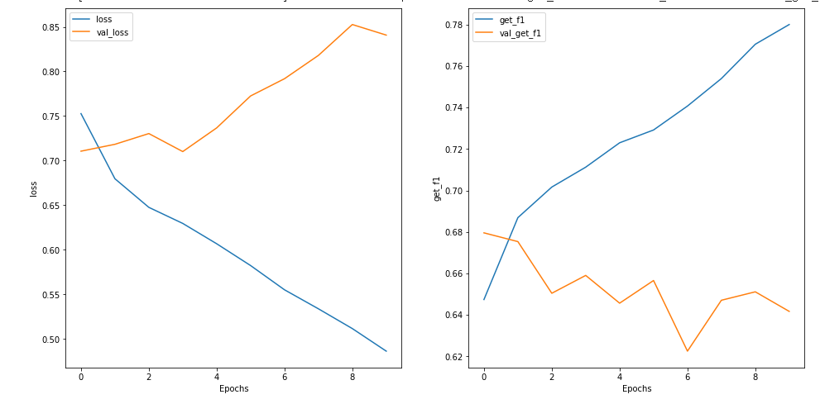
Subtask B: Detecting offensive language is targeted or untargeted
LSTM Model output

